Slide 1



IdentityWallet
B.SC. IT PROJECT PRESENTATION
Digital Identity Wallet
Privacy-preserving digital identity management with verifiable credentials, selective disclosure and an encrypted vault
National Identity Card
National Identity Authority (Demo)
Java 17
Spring Boot
React
ECDSA P-256
AES-256-GCM
TOTP 2FA
Age over 18 · Verified
Cecil Baraik
Roll No. 2025-BSCIT/004A · B.Sc. Information Technology
Amity University Jharkhand
Notes:
Good morning. My project is IdentityWallet, a digital identity wallet. Organisations issue digitally signed credentials into a person's wallet, and the person shares only the details a verifier needs, for example proving they are over 18 without revealing their date of birth. It is built with Spring Boot and React, using ECDSA signatures, AES-256-GCM encryption and two-factor authentication.

Slide 2




Sharing your ID today reveals too much
A cinema needs one fact.
A photocopy of an ID card gives away eight: name, birth date, gender, ID number, nationality, address, photo and signature.
Over-sharing
Easy to forge
Every detail is exposed even when only one fact is needed
Scans and photocopies can be edited in minutes; receivers can't check them
Once handed over, the owner has no control over where it goes or how long it is kept.
No consent or tracking
No revocation
No expiry, no view limit, no idea who looked at it
A cancelled licence keeps "working" as long as a copy exists
Notes:
Today we share photocopies. A cinema only needs to know I am over 18, but the photocopy shows eight details. Copies are easy to forge, there is no consent or expiry, and nothing can be revoked. These four problems are what the project solves.

Slide 3



The idea: share facts, not photocopies
signed
credential
chosen
details
Issuer
Holder
Verifier
Govt. office, college, RTO
You, in your wallet
Bank, cinema, employer
Signs credentials with its private key (ECDSA)
Keeps them encrypted and chooses what to reveal
Checks signatures in seconds, no account needed
Example: the cinema sees only "Age over 18: Yes" — name, birth date and ID number stay hidden, yet it can't be faked.
Notes:
The solution follows the W3C verifiable credentials model: an issuer signs a credential, the holder keeps it and chooses what to share, and the verifier checks the signature. The verifier never needs to contact the issuer.

Slide 4
Project objectives
01
02
03
Tamper-proof credentials
Selective disclosure
Holder consent
Issuers sign with ECDSA P-256; any change is detected
Reveal chosen details — even "age over 18" without the birth date
Recipient, purpose, expiry, view limit, stop sharing, access log
04
05
06
Instant verification
Encrypted vault
Strong account security
Link, QR scan or file — no account, five automatic checks
AES-256-GCM with per-user keys; the database alone reveals nothing
2FA, PBKDF2 hashing, lockout, rate limits, tamper-evident audit log
Notes:
These are the six objectives. Each one maps to a module in the system, and each is covered by tests.

Slide 5







Key features
Signed credentials
Selective disclosure
QR & link sharing
Access log
6 templates + custom claims
Share any subset, derived age claims
Expiry and view limits per share
Who opened it, when, which device
Public verifier
Encrypted vault
Two-factor login
Hash-chained audit
Five checks, camera QR scanning
PDF / image docs, AES-256-GCM
TOTP with any authenticator app
Tamper-evident event history
Notes:
Here are the eight key features. Three roles use them: holders, issuers and administrators, plus verifiers who need no account.

Slide 6
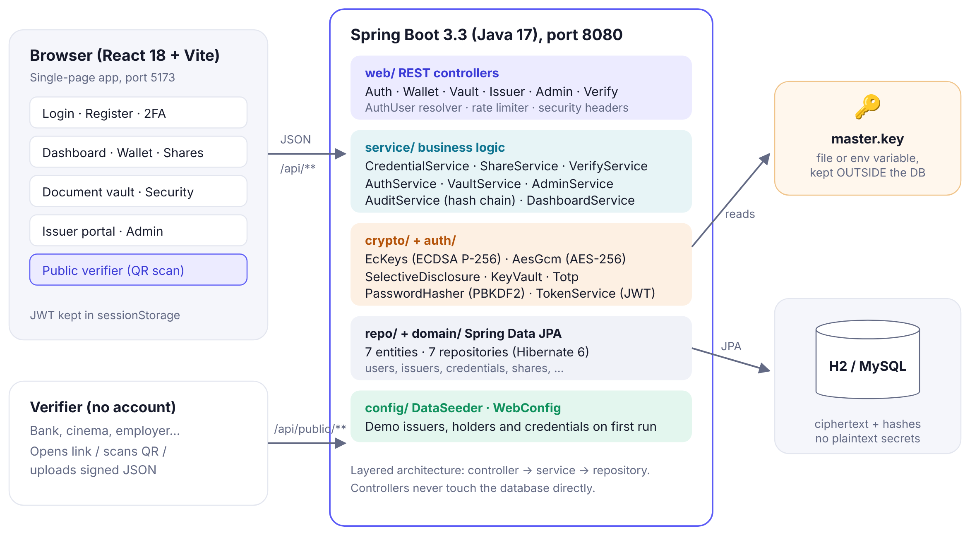



System architecture
React 18 SPA
Role-based pages; token in sessionStorage
Layered Spring Boot
Controller → Service → Repository
Key outside the DB
Master key in a file or env variable
Notes:
A three-tier architecture. The React app talks to Spring Boot over REST. The backend is layered: controllers, services, crypto utilities and repositories. Sensitive data is encrypted, and the master key is stored outside the database.

Slide 7

Technology stack
Frontend
Backend
Security
React 18 + React Router 6
Vite 5 dev server & build
qrcode.react — QR codes
jsQR — camera scanning
lucide-react icons
Java 17
Spring Boot 3.3 (Web, JPA, Validation)
Hibernate 6 ORM
H2 (dev) · MySQL 8 (prod)
JUnit 5 + MockMvc tests
ECDSA P-256 signatures
AES-256-GCM encryption
SHA-256 · PBKDF2 (210k)
JWT (HS256) sessions
TOTP (RFC 6238) 2FA
No custom crypto: every algorithm comes from the standard Java Cryptography Architecture and published NIST / IETF standards.
Notes:
Java and Spring Boot for the backend because of strong typing and the built-in Java Cryptography Architecture. React for an interactive UI. All cryptography uses standard, well-reviewed algorithms.

Slide 8
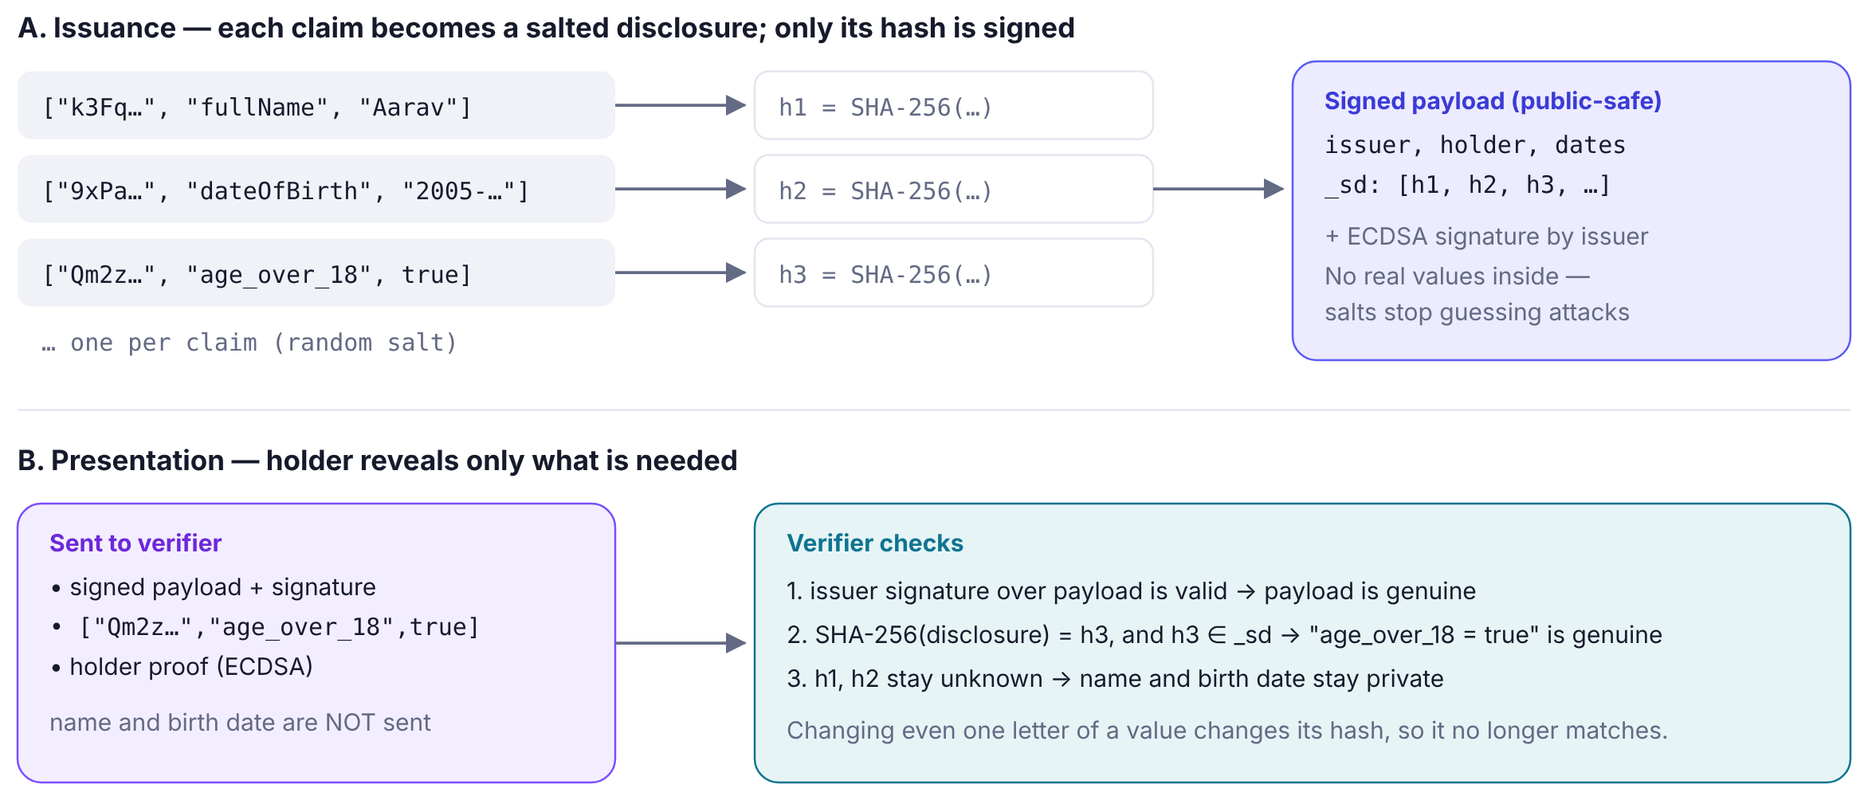
How selective disclosure works
Change one letter → its hash no longer matches. Hidden values can't be guessed because of the random salt.
Notes:
Each claim is turned into a disclosure: salt, name and value. Only its SHA-256 hash goes into the signed credential. To share, the holder sends only the chosen disclosures. The verifier hashes them and finds the hash in the signed list. Hidden claims stay secret, and the random salt stops guessing attacks.

Slide 9
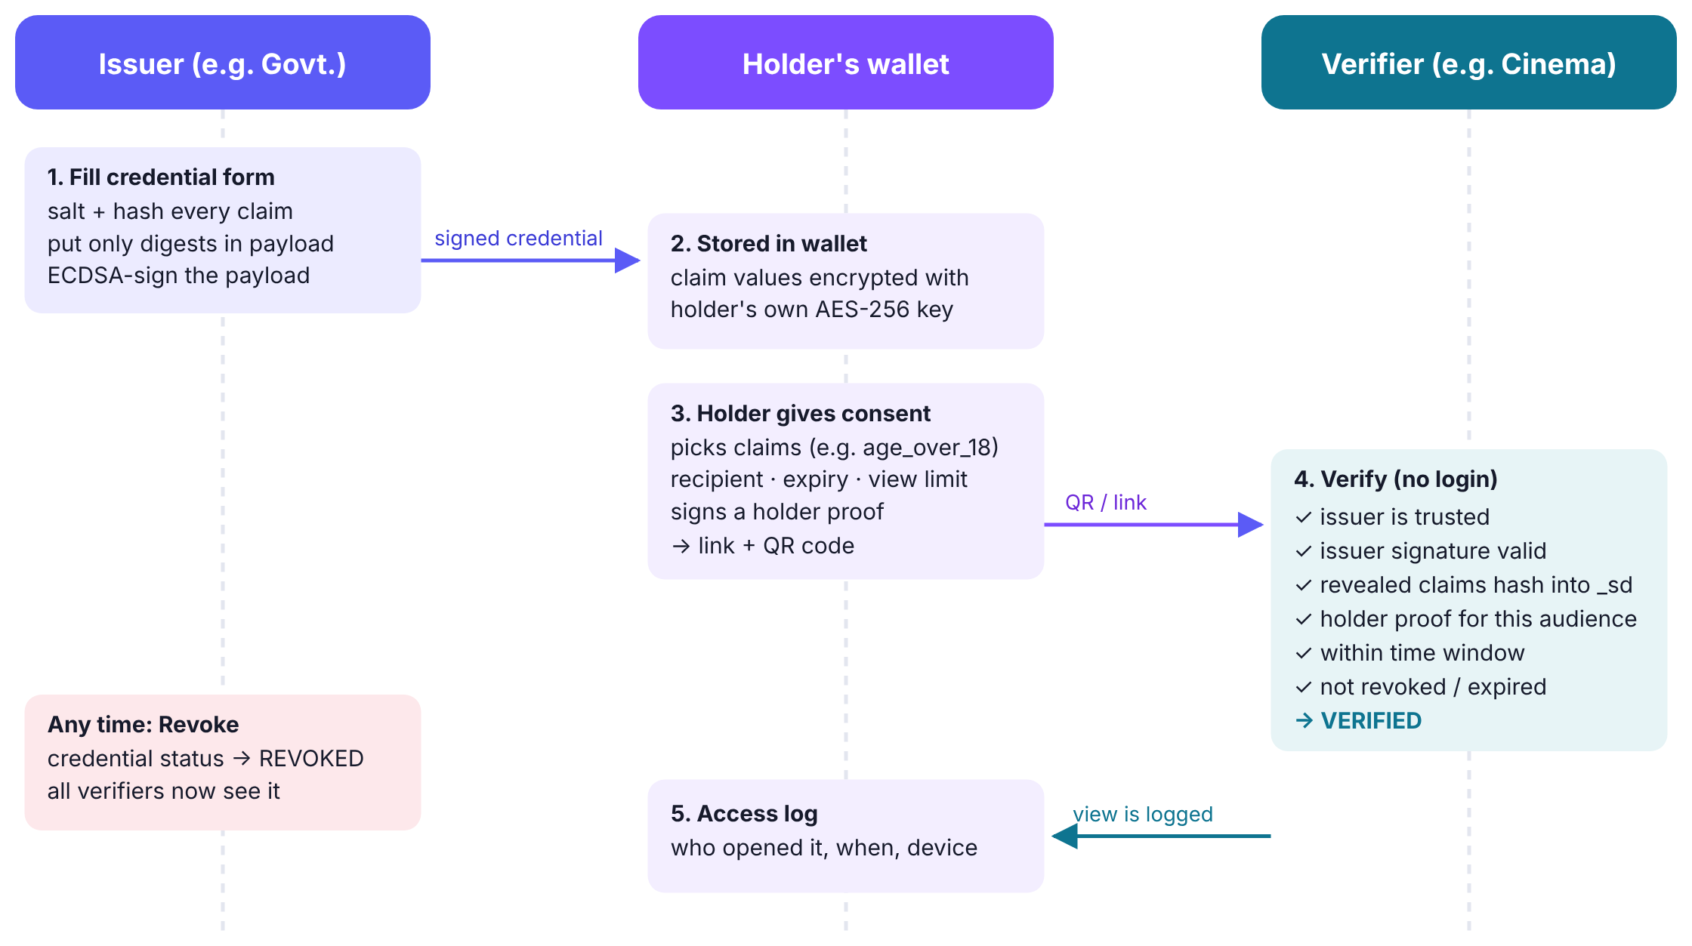
Credential lifecycle
Notes:
The full lifecycle: the issuer signs, the wallet stores the claims encrypted, the holder gives consent and gets a QR code, the verifier checks, and each view is logged. The issuer can revoke at any time.

Slide 10
Verification: five automatic checks
1
2
3
4
5
Trusted issuer
Issuer signature
Revealed details
Holder consent
Time & status
In the registry, not suspended
ECDSA over the payload is valid
Each hash is in the signed list
Owner signed for this recipient
Not expired, not revoked
All pass → VERIFIED
If any check fails the verifier sees NOT VERIFIED with the exact reason.
Notes:
The verifier runs five independent checks. One: is the issuer in the trust registry? Two: is the issuer signature valid? Three: do the revealed details match the signed hashes? Four: did the holder sign this share for this recipient? Five: is it within the time window and not revoked? Only if all pass is it verified.

Slide 11
Security in numbers
AES-256
P-256
210,000
GCM encryption for vault, claims and keys
ECDSA keys for issuer and holder signatures
PBKDF2 iterations per password hash
2FA
5 → 5 min
SHA-256
TOTP codes every 30 s (RFC 6238)
Wrong passwords before a 5-minute lockout
Hash chain makes the audit log tamper-evident
Notes:
Security in numbers: AES-256-GCM encryption, P-256 ECDSA signatures, 210 thousand PBKDF2 iterations, time-based two-factor codes, lockout after five wrong passwords, and a SHA-256 hash chain for the audit log. Envelope encryption means a stolen database is only ciphertext.

Slide 12
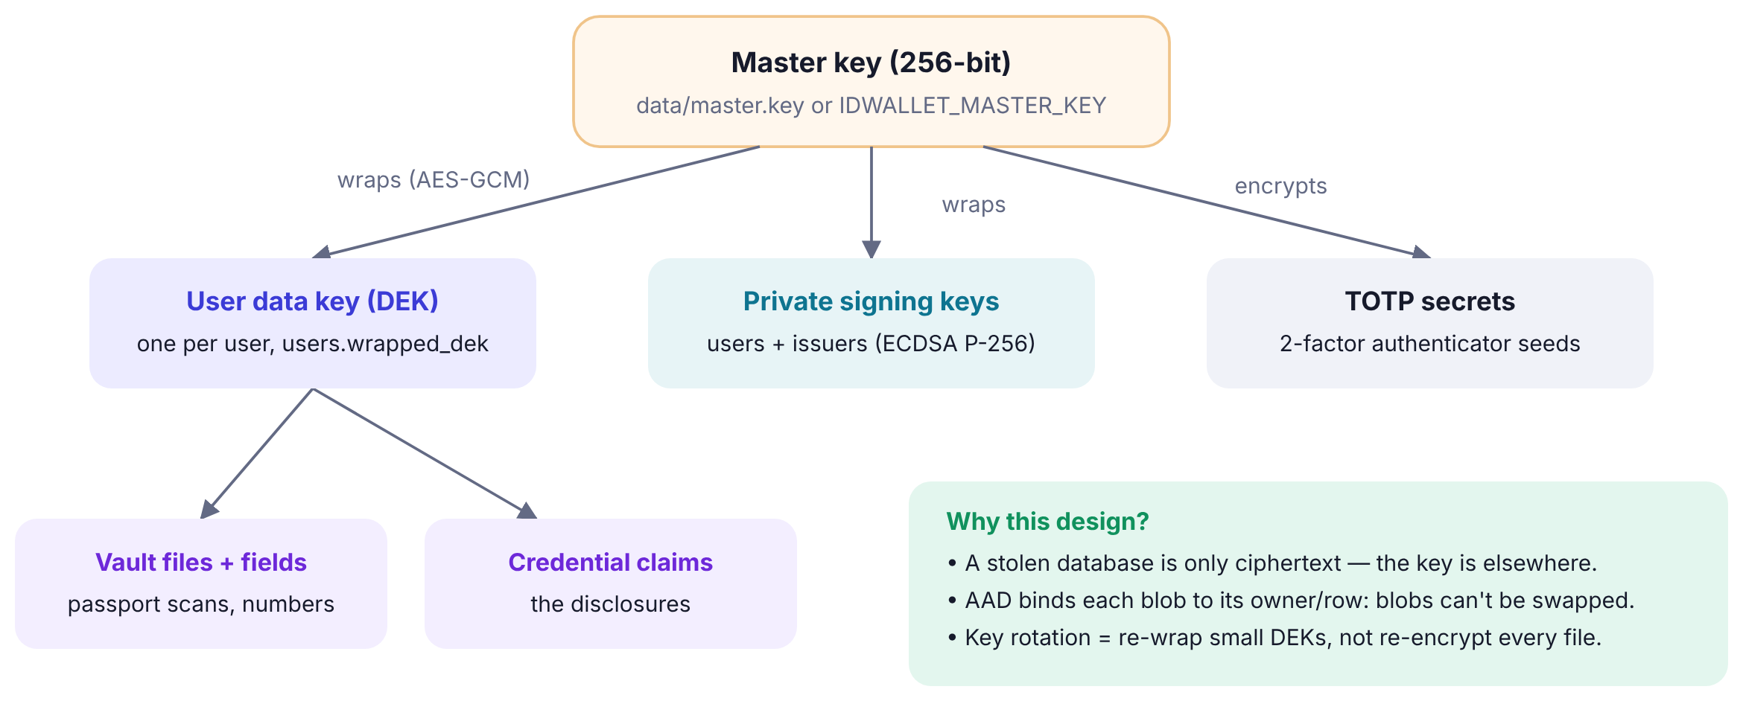

If the database is stolen…
Attacker gets…
Passwords
PBKDF2 hashes only
Keys & 2FA secrets
Encrypted with master key
Vault & claims
AES-256-GCM ciphertext
Share links
Only SHA-256 of tokens
Also handled: IDOR (404 for others' records), brute force (lockout + rate limits), account enumeration (same error + dummy hash), fake uploads (magic-byte check), replay (holder proof).
Credentials
Signed hashes, no values
Notes:
Envelope encryption: one master key, kept outside the database, wraps each user's data key, which encrypts their data. If the database is stolen, the attacker only gets hashes and ciphertext. I also handle IDOR, brute force, account enumeration, fake file uploads and replay attacks.

Slide 13
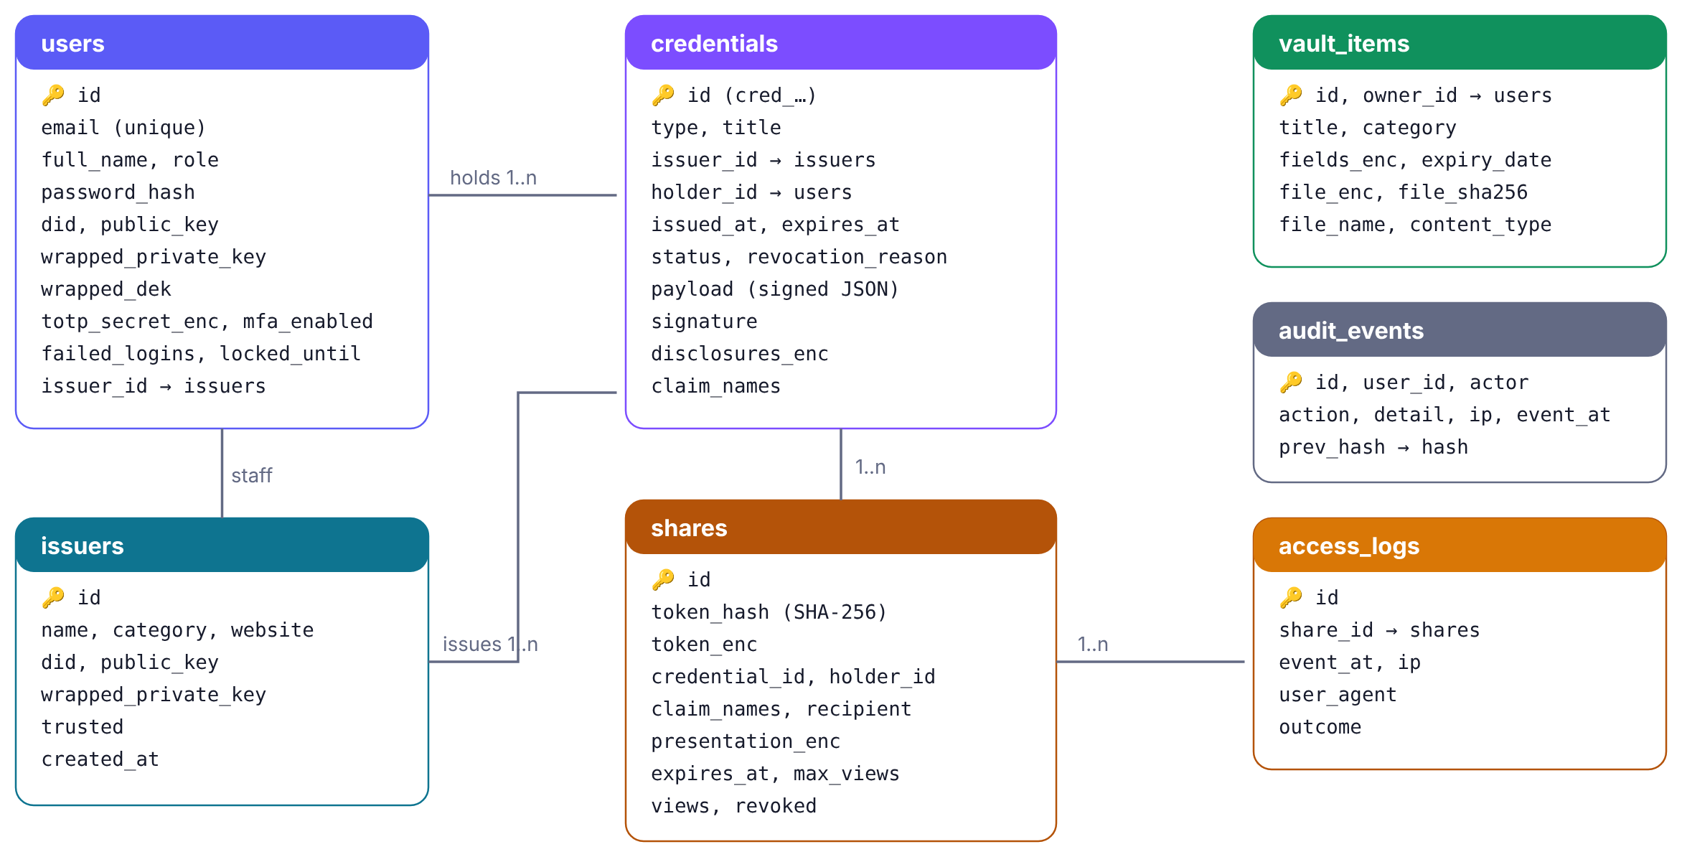
Database design
7 tables
Spring Data JPA + Hibernate. Sensitive columns hold only ciphertext or hashes (…_enc, …_hash).
Notes:
Seven tables. Users, issuers as the trust registry, credentials, shares with their access logs, vault items and audit events. Every column ending in enc is encrypted and every hash column is a one-way hash.

Slide 14
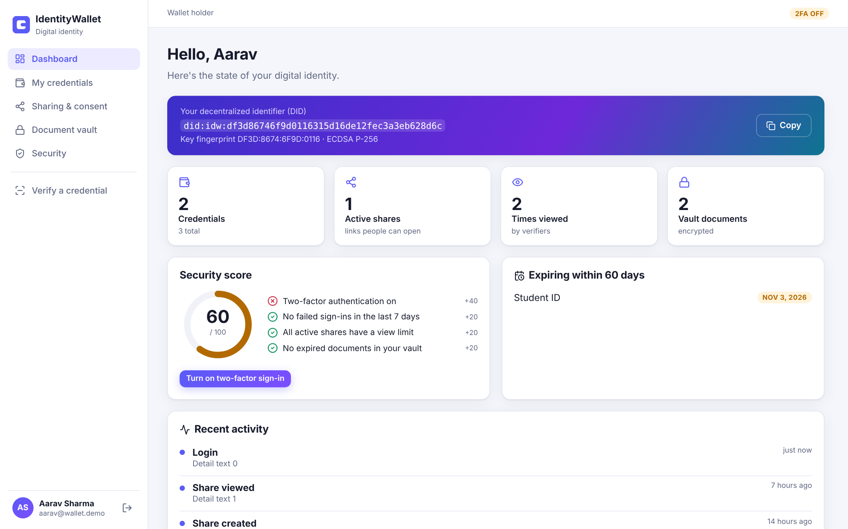
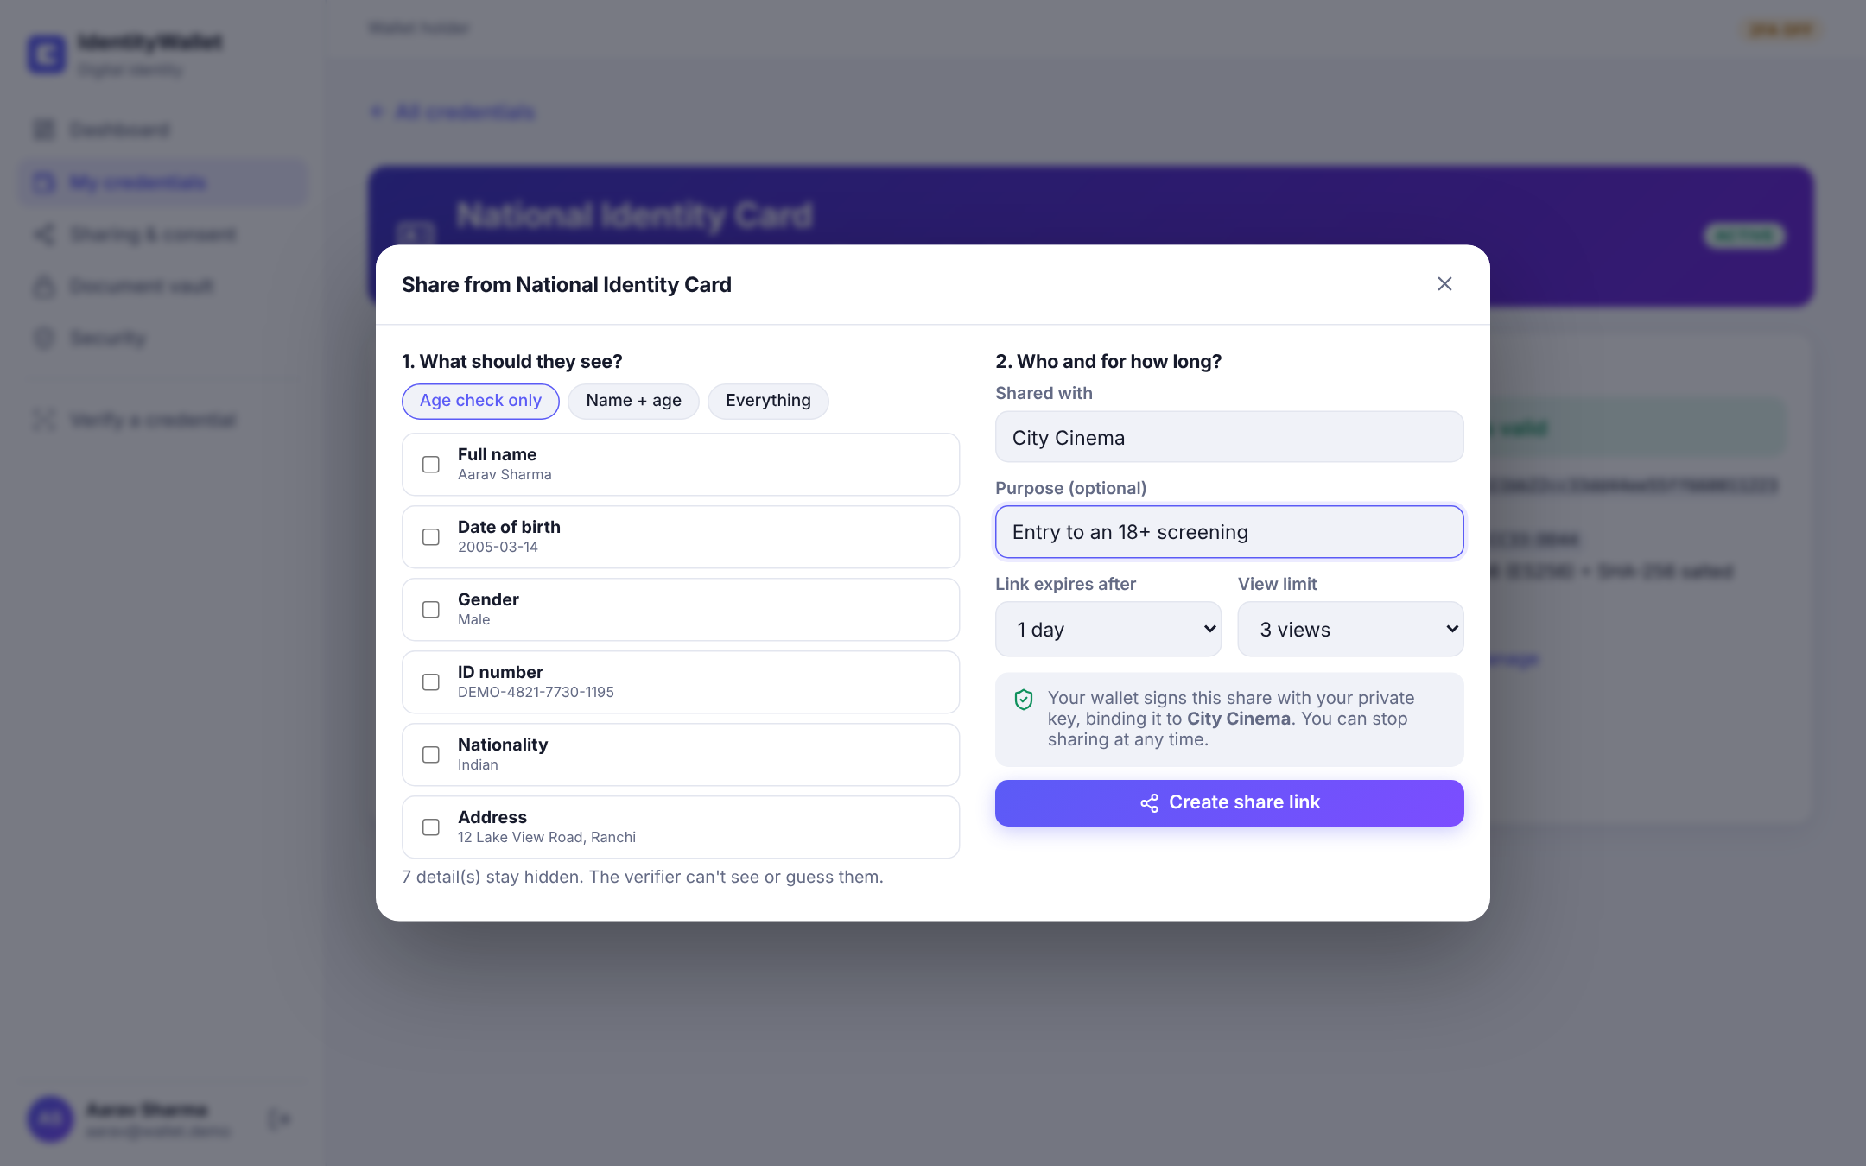
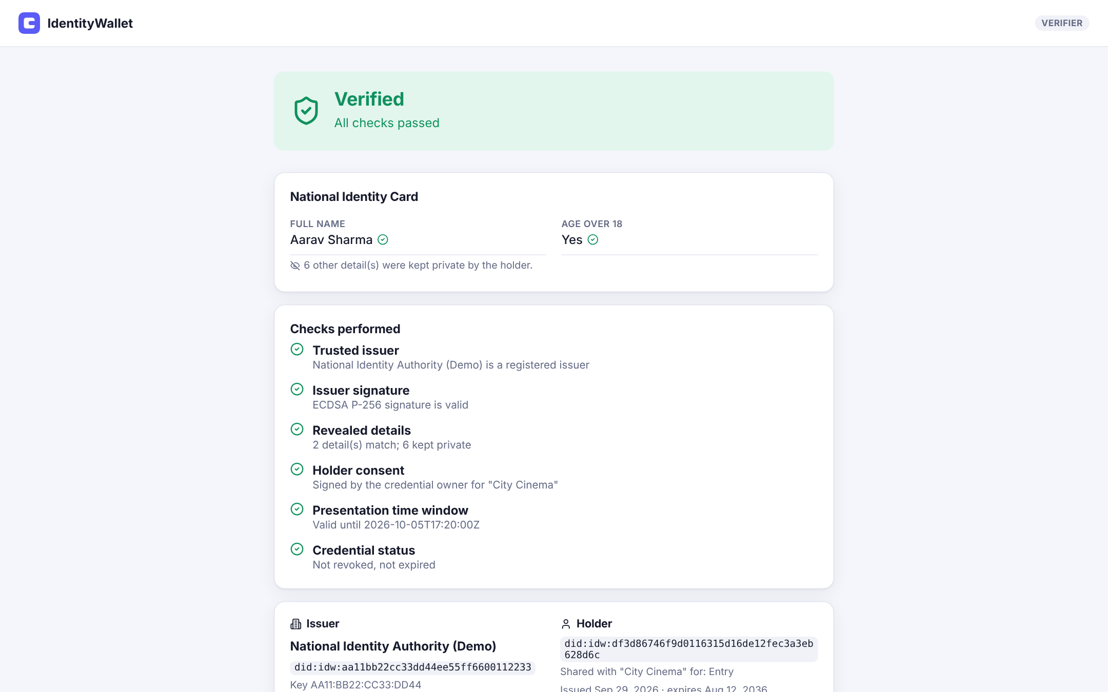
App walkthrough: hold → share → verify
1 Hold
2 Share
3 Verify
Dashboard with DID, credentials and security score
Pick details, recipient, expiry and view limit
Verifier sees only "Age over 18" — all checks pass
Live demo: Aarav shares "Age check only" with City Cinema → the link shows Verified with 7 details kept private.
Notes:
A quick walkthrough. The holder sees their DID and credentials. They open a credential, choose Age check only, enter City Cinema and get a QR code. The cinema scans it and sees only Age over 18, with all five checks green. I can also show this live.

Slide 15
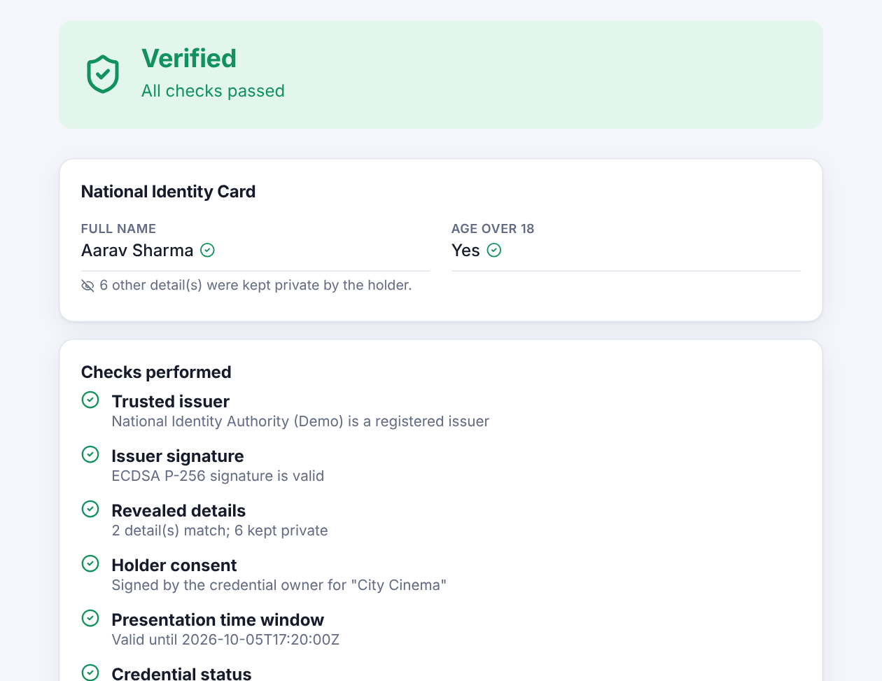
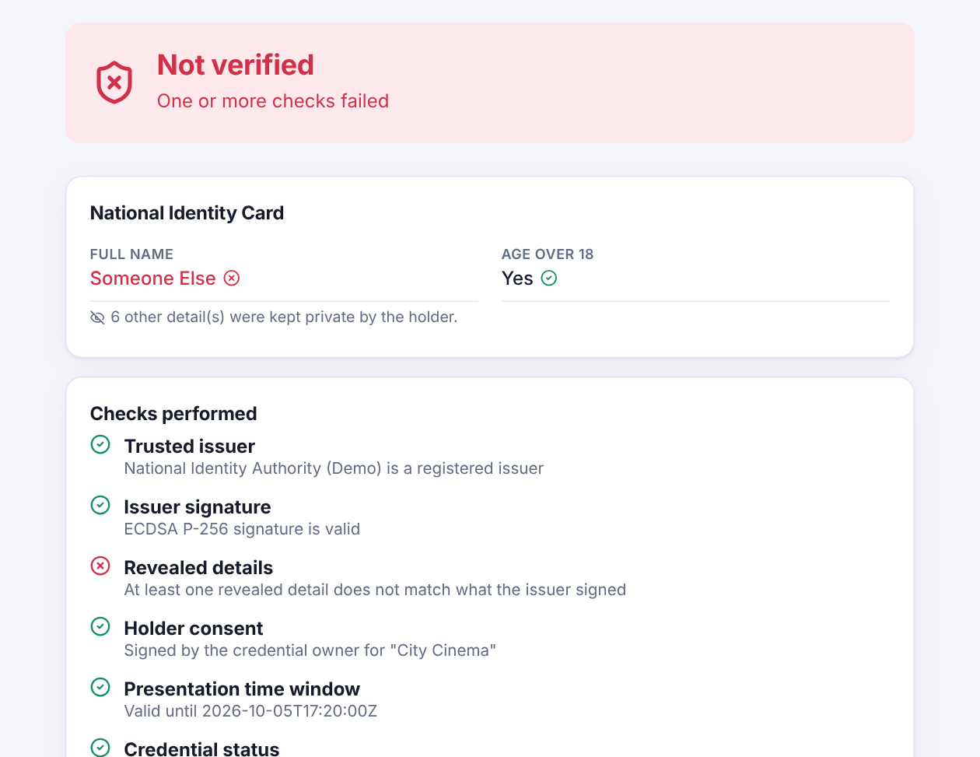

Tampering is caught instantly
Genuine share
Name changed by an attacker
Notes:
On the left, a genuine share: all checks pass. On the right, someone edited the revealed name to Someone Else. Its hash no longer matches the issuer-signed list, so Revealed details fails and the result is Not verified.

Slide 16
Testing results
TOTP matches the RFC 6238 test vector
Revoked credential fails status check
8 / 8
AES-GCM detects tampering and wrong context
401 / 403 / 404 for missing token, wrong role, others' data
automated tests passed
ECDSA rejects modified messages
Fake PDF upload rejected
BUILD SUCCESS
Forged claim → verification fails
2FA wrong code rejected; lockout after 5 tries
5 cryptography unit tests
3 full-flow integration tests (MockMvc)
View limit enforced (3rd view refused)
Audit hash chain intact
Notes:
All eight automated tests pass. They are not just happy-path tests: they try to forge claims, exceed view limits, use revoked credentials, access other users' data, upload fake files and brute-force passwords. Every attack is blocked.

Slide 17


Limitations and future scope
Current limitations
Future scope
Keys held (encrypted) on the server
SD-JWT-style format, not yet interoperable
Revocation needs an online check
In-memory rate limits (single server)
Mobile wallet with keys in the phone's secure enclave + biometrics
Passkeys (WebAuthn) for passwordless login
Standard SD-JWT VC / W3C VC 2.0 and OpenID4VP
Privacy-preserving revocation with status lists
Zero-knowledge proofs (BBS+) for unlinkable sharing
Docker deployment with HTTPS and Redis
Notes:
Being honest about limitations: keys are custodial, the format is not yet fully standard, and revocation needs an online check. Future work includes a mobile wallet with hardware-backed keys, passkeys, standard formats and zero-knowledge proofs.

Slide 18
CONCLUSION
Verifiable and private, at the same time
Can't be forged
Shares only what's needed
Owner stays in control
Issuer signatures + trust registry
Selective disclosure and derived claims
Consent, expiry, view limits, access log
Thank you
Questions? · Cecil Baraik · 2025-BSCIT/004A
Notes:
To conclude: IdentityWallet shows that digital identity can be verifiable and private at the same time. Credentials cannot be forged, holders share only what is needed, and they stay in control of every share. Thank you, I am happy to take questions or show a live demo.

